Slide 1

Offline Solutions
to Online Problems
Dalya Gartzman
Offline Solutions
to Online Problems
Dalya Gartzman

Slide 2
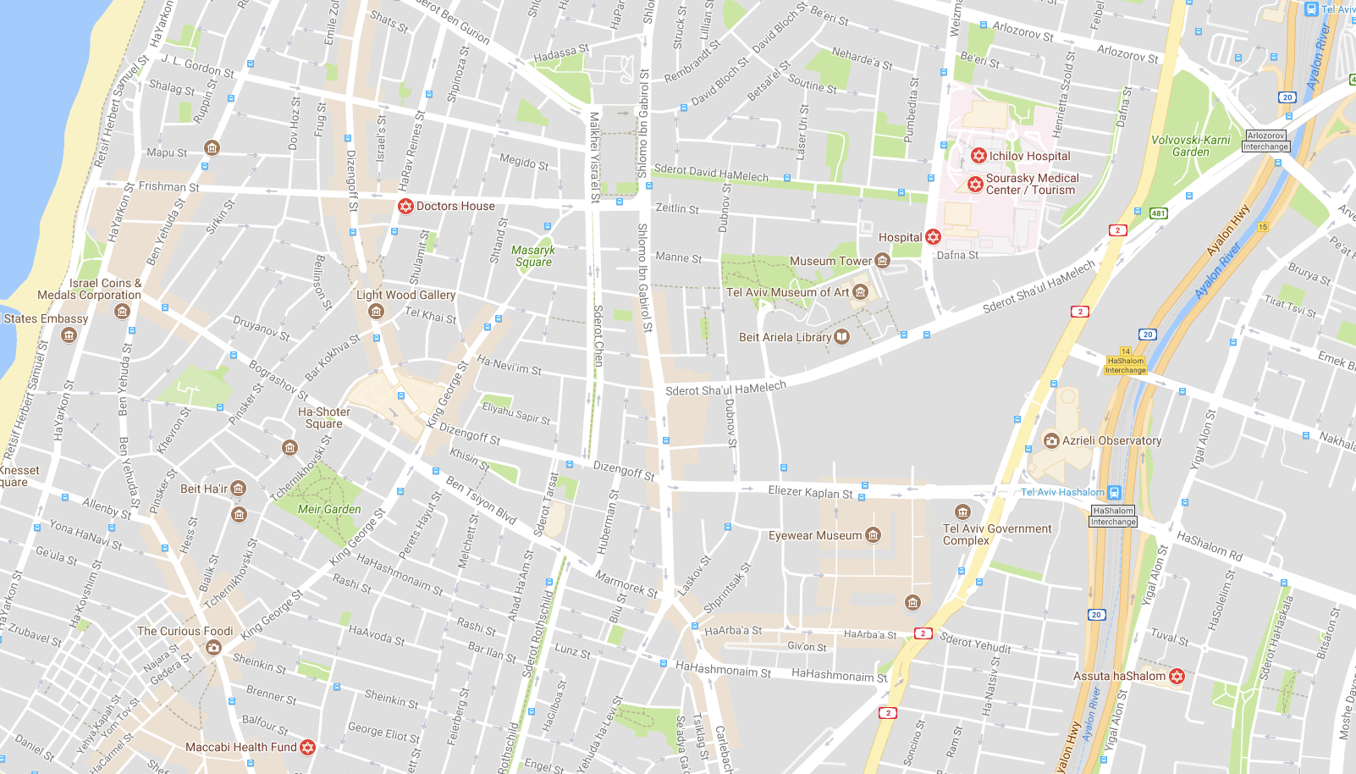



What does it mean?
08:07

Slide 3
What does it mean?
08:17
08:07

Slide 4

What does it mean?
08:17
08:07

Slide 5
What does it mean?
08:17
08:07

Slide 6

What does it mean?

Slide 7
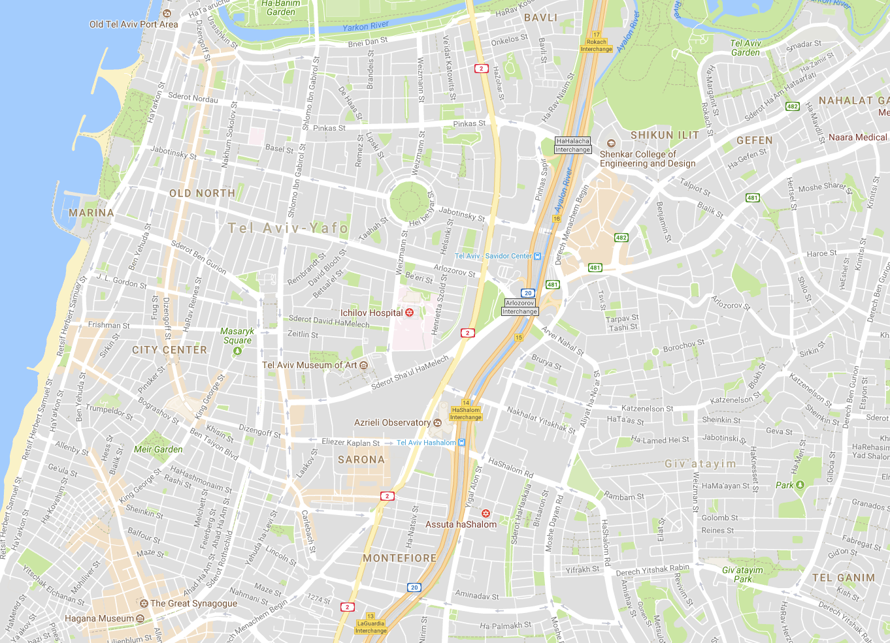
Our Motivation
online problem - individual actions
offline solution - smarter decisions

Slide 8
networkx
import networkx as nx
def BuildGraph(requests, vans):
G = nx.Graph()
# build left side
G.add_nodes_from([ (r.name, {‘data’:r.data}) for r in requests ])
# build middle side
G.add_nodes_from([ (c.name, {‘data’:c.data})
for c in GetClusters(requests) ])
G.add_edges_from([ (r, c) for r,c in requests,clusters])
# build right side
G.add_nodes_from([ (v.name, {‘data’:v.data}) for v in vans ])
G.add_edges_from([(c,v) for c,v in clusters, vans
if CanVanTakeCluster(v,c)])
return G

Slide 9
import networkx as nx
def BuildGraph(requests, vans):
G = nx.Graph()
# build left side
G.add_nodes_from([ (r.name, {‘data’:r.data}) for r in requests ])
# build middle side
G.add_nodes_from([ (c.name, {‘data’:c.data})
for c in GetClusters(requests) ])
G.add_edges_from([ (r, c) for r,c in requests,clusters ])
# build right side
G.add_nodes_from([ (v.name, {‘data’:v.data}) for v in vans ])
G.add_edges_from([(c,v) for c,v in clusters, vans
if CanVanTakeCluster(v,c)])
return G

Slide 10

import networkx as nx
def BuildGraph(requests, vans):
G = nx.Graph()
# build left side
G.add_nodes_from(
[ (r.name, {‘data’:r.data})
for r in requests ])
# build middle side
G.add_nodes_from([ (c.name, {‘data’:c.data})
for c in GetClusters(requests) ])
G.add_edges_from([ (r, c) for r,c in requests,clusters ])
# build right side
G.add_nodes_from([ (v.name, {‘data’:v.data}) for v in vans ])
G.add_edges_from([(c,v) for c,v in clusters, vans if CanVanTakeCluster(v,c)])
return G

Slide 11

import networkx as nx
def BuildGraph(requests, vans):
G = nx.Graph()
# build left side
G.add_nodes_from([(r.name, {‘data’:r.data}) for r in requests])
# build middle side
G.add_nodes_from([
(c.name,{‘data’:c.data})
for c in GetClusters(requests)])
G.add_edges_from([ (r, c) for r,c in requests,clusters ])
# build right side
G.add_nodes_from([ (v.name, {‘data’:v.data}) for v in vans ])
G.add_edges_from([(c,v) for c,v in clusters, vans if CanVanTakeCluster(v,c)])
return G

Slide 12

import networkx as nx
def BuildGraph(requests, vans):
G = nx.Graph()
# build left side
G.add_nodes_from([(r.name, {‘data’:r.data}) for r in requests])
# build middle side
G.add_nodes_from([ (c.name, {‘data’:c.data})
for c in GetClusters(requests) ])
G.add_edges_from([ (r, c) for r,c in requests,clusters ])
# build right side
G.add_nodes_from(
[ (v.name, {‘data’:v.data})
for v in vans ])
G.add_edges_from([(c,v) for c,v in (middle_layer), vans
if CanVanTakeClique(v,c)])
return G

Slide 13
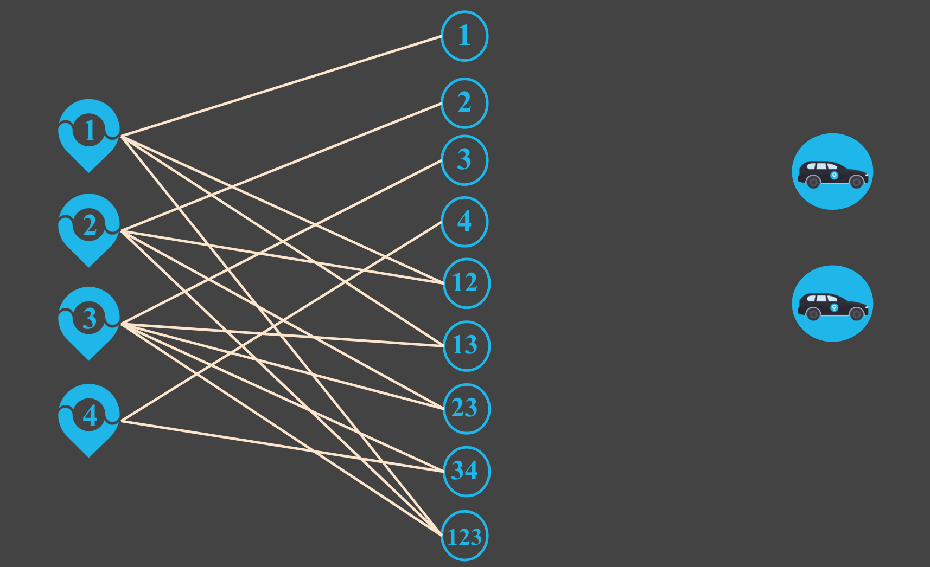
import networkx as nx
def BuildGraph(requests, vans):
G = nx.Graph()
# build left side
G.add_nodes_from([ (r.name, {‘data’:r.data}) for r in requests ])
# build middle side
G.add_nodes_from([ (c.name, {‘data’:c.data})
for c in GetClusters(requests) ])
G.add_edges_from(
[(r,c) for r,c in requests,clusters])
# build right side
G.add_nodes_from([ (v.name, {‘data’:v.data}) for v in vans ])
G.add_edges_from([(c,v) for c,v in clusters, vans
if CanVanTakeCluster(v,c)])
return G

Slide 14
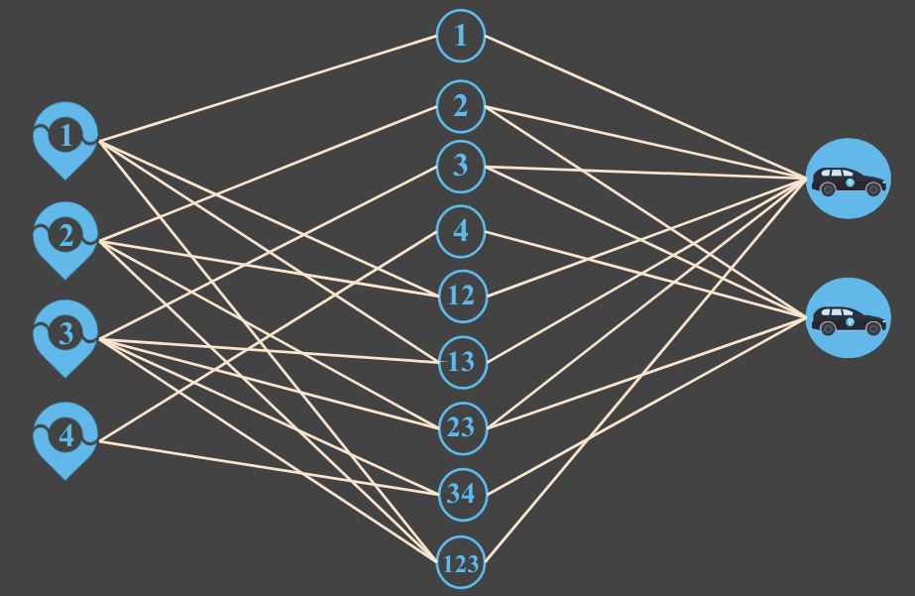
import networkx as nx
def BuildGraph(requests, vans):
G = nx.Graph()
# build left side
G.add_nodes_from([ (r.name, {‘data’:r.data}) for r in requests ])
# build middle side
G.add_nodes_from([ (c.name, {‘data’:c.data})
for c in GetClusters(requests) ])
G.add_edges_from([ (r,c) for r,c in requests,clusters ])
# build right side
G.add_nodes_from([ (v.name, {‘data’:v.data}) for v in vans ])
G.add_edges_from(
[(c,v) for c,v in clusters,vans
if CanVanTakeCluster(v,c)])
return G

Slide 15
import networkx as nx
def BuildGraph(requests, vans):
G = nx.Graph()
# build left side
G.add_nodes_from([ (r.name, {‘data’:r.data}) for r in requests ])
# build middle side
G.add_nodes_from([ (c.name, {‘data’:c.data})
for c in GetClusters(requests) ])
G.add_edges_from([ (r,c) for r,c in requests,clusters ])
# build right side
G.add_nodes_from([ (v.name, {‘data’:v.data}) for v in vans ])
G.add_edges_from([(c,v) for c,v in clusters, vans
if CanVanTakeCluster(v,c)])
G.draw()
return G

Slide 16
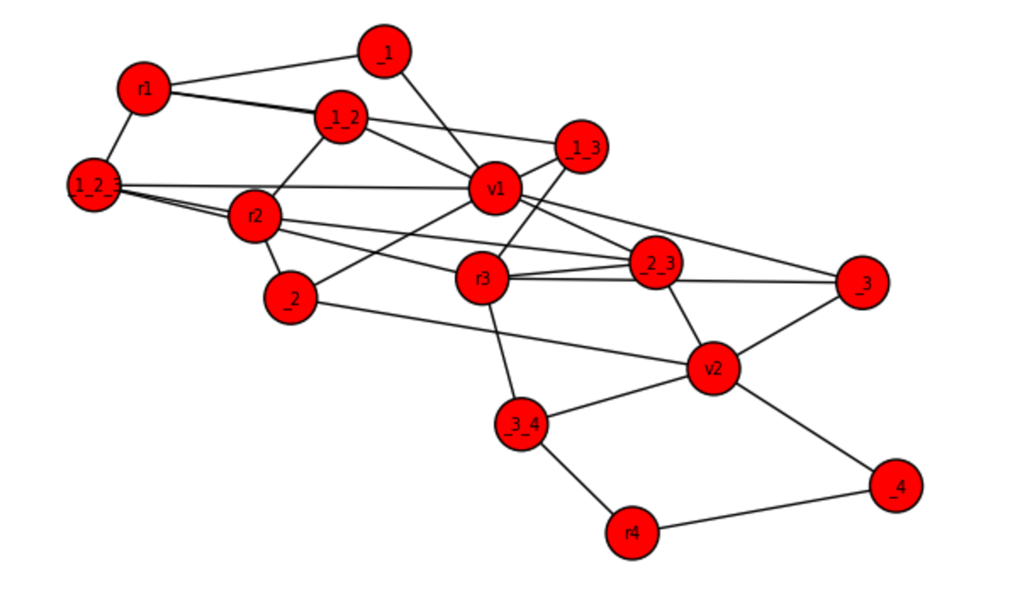

import networkx as nx
def BuildGraph(requests, vans):
G = nx.Graph()
# build left side
G.add_nodes_from([ (r.name, {‘data’:r.data}) for r in requests ])
# build middle side
G.add_nodes_from([ (c.name, {‘data’:c.data})
for c in GetClusters(requests) ])
G.add_edges_from([ (r,c) for r,c in requests,clusters ])
# build right side
G.add_nodes_from([ (v.name, {‘data’:v.data}) for v in vans ])
G.add_edges_from([(c,v) for c,v in clusters, vans
if CanVanTakeCluster(v,c)])
G.draw()
return G

Slide 17
import networkx as nx
def BuildGraph(requests, vans):
G = nx.Graph()
# build left side
G.add_nodes_from([ (r.name, {‘data’:r.data}) for r in requests ])
# build middle side
G.add_nodes_from([ (c.name, {‘data’:c.data})
for c in GetClusters(requests) ])
G.add_edges_from([ (r, c) for r,c in requests,clusters ])
# build right side
G.add_nodes_from([ (v.name, {‘data’:v.data}) for v in vans ])
G.add_edges_from([(c,v) for c,v in clusters, vans
if CanVanTakeCluster(v,c)])
# define position for draw
pos =
{r.name: [0,idx]
for idx,r in enumerate(requests)} + \
{ c.name: [1,idx] for idx,c in enumerate(GetClusters(G))} + \
{ v.name: [2,idx] for idx,v in enumerate(vans)}
nx.draw(G,pos)
return G

Slide 18
import networkx as nx
def BuildGraph(requests, vans):
G = nx.Graph()
# build left side
G.add_nodes_from([ (r.name, {‘data’:r.data}) for r in requests ])
# build middle side
G.add_nodes_from([ (c.name, {‘data’:c.data})
for c in GetClusters(requests) ])
G.add_edges_from([ (r,c) for r,c in requests,clusters ])
# build right side
G.add_nodes_from([ (v.name, {‘data’:v.data}) for v in vans ])
G.add_edges_from([(c,v) for c,v in clusters, vans
if CanVanTakeCluster(v,c)])
# define position for draw
pos =
{r.name: [0,idx] for idx,r in enumerate(requests)} + \
{ c.name: [1,idx] for idx,c
in enumerate(GetClusters(G))} + \
{ v.name: [2,idx] for idx,v in enumerate(vans)}
nx.draw(G,pos)
return G

Slide 19
import networkx as nx
def BuildGraph(requests, vans):
G = nx.Graph()
# build left side
G.add_nodes_from([ (r.name, {‘data’:r.data}) for r in requests ])
# build middle side
G.add_nodes_from([ (c.name, {‘data’:c.data})
for c in GetClusters(requests) ])
G.add_edges_from([ (r,c) for r,c in requests,clusters ])
# build right side
G.add_nodes_from([ (v.name, {‘data’:v.data}) for v in vans ])
G.add_edges_from([(c,v) for c,v in clusters, vans
if CanVanTakeCluster(v,c)])
# define position for draw
pos =
{r.name: [0,idx] for idx,r in enumerate(requests)} + \
{ c.name: [1,idx] for idx,c in enumerate(GetClusters(G))} + \
{ v.name: [2,idx] for idx,v
in enumerate(vans)}
nx.draw(G,pos)
return G

Slide 20
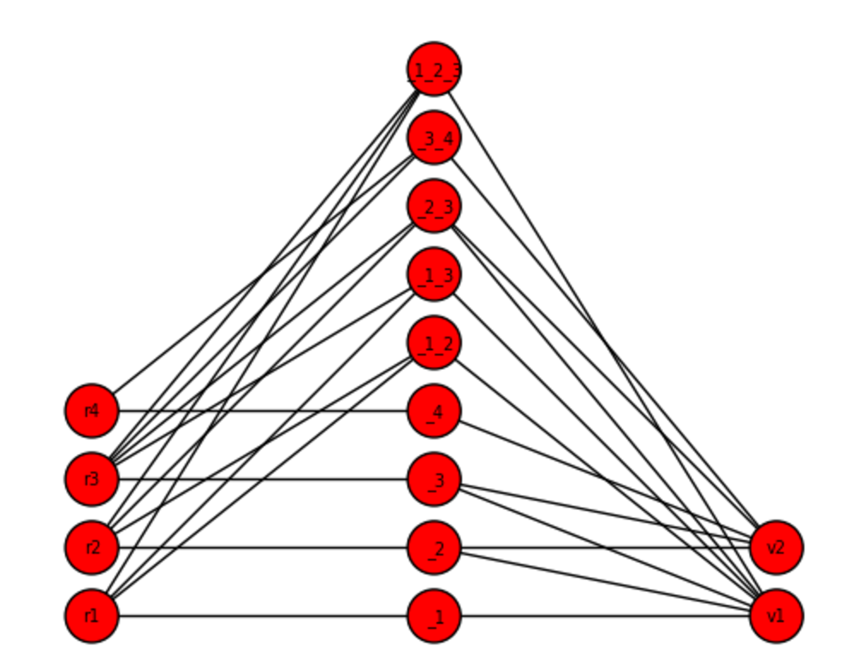

import networkx as nx
def BuildGraph(requests, vans):
G = nx.Graph()
# build left side
G.add_nodes_from([ (r.name, {‘data’:r.data}) for r in requests ])
# build middle side
G.add_nodes_from([ (c.name, {‘data’:c.data})
for c in GetClusters(requests) ])
G.add_edges_from([ (r,c) for r,c in requests,clusters ])
# build right side
G.add_nodes_from([ (v.name, {‘data’:v.data}) for v in vans ])
G.add_edges_from([(c,v) for c,v in clusters, vans
if CanVanTakeCluster(v,c)])
# define position for draw
pos =
{r.name: [0,idx] for idx,r in enumerate(requests)} + \
{ c.name: [1,idx] for idx,c in enumerate(GetClusters(G))} + \
{ v.name: [2,idx] for idx,v in enumerate(vans)}
nx.draw(G,pos)
return G

Slide 21

networkx
List [comprehension]
Helper functions for logical structure
Use “pos” for easy drawing
1
2
3

